Slide 1
Chapter 14
Methodology -
Conceptual Database Design
Transparencies

Slide 2
Chapter 14 - Objectives
Purpose of a design methodology.
Database design has three main phases: conceptual, logical, and physical design.
How to decompose the scope of the design into specific users’ views of the enterprise.
How to use ER modeling to build a local conceptual data model based on information given in a view of the enterprise.

Slide 3
Chapter 14 - Objectives
How to validate resultant conceptual model to ensure it is a true and accurate representation of a view of the enterprise.
How to document process of conceptual database design.
End-users play an integral role throughout process of conceptual database design.

Slide 4
Design Methodology
Structured approach that uses procedures, techniques, tools, and documentation aids to support and facilitate the process of design.
Database design methodology has 3 main phases:
  Conceptual database design;
  Logical database design;
  Physical database design.

Slide 5
Conceptual/Logical Database Design
Conceptual database design
  Process of constructing a model of information used in an enterprise, independent of all physical considerations.
Logical database design
  Process of constructing a model of information used in an enterprise based on a specific data model (e.g. relational), but independent of a particular DBMS and other physical considerations.

Slide 6
Physical Database Design
Process of producing a description of the implementation of the database on secondary storage; it describes the base relations, file organizations, and indexes design used to achieve efficient access to the data, and any associated integrity constraints and security measures.

Slide 7
Critical Success Factors in Database Design
Work interactively with users as much as possible.
Follow a structured methodology throughout the data modeling process.
Employ a data-driven approach.
Incorporate structural and integrity considerations into the data models.
Combine conceptualization, normalization, and transaction validation techniques into the data modeling methodology.

Slide 8
Critical Success Factors in Database Design
Use diagrams to represent as much of the data models as possible.
Use a Database Design Language (DBDL) to represent additional data semantics.
Build a data dictionary to supplement the data model diagrams.
Be willing to repeat steps.

Slide 9
Methodology Overview - Conceptual Database Design
Step 1 Build local conceptual data model for each user view
  Step 1.1 Identify entity types
  Step 1.2 Identify relationship types
  Step 1.3 Identify and associate attributes with entity or relationship types
  Step 1.4 Determine attribute domains
  Step 1.5 Determine candidate and primary key attributes
  Step 1.6 Consider use of enhanced modeling concepts (optional step)
  Step 1.7 Check model for redundancy
  Step 1.8 Validate local conceptual model against user transactions
  Step 1.9 Review local conceptual data model with user

Slide 10
Methodology Overview - Logical Database Design for Relational Model
Step 2 Build and validate local logical data model for each view
  Step 2.1 Remove features not compatible with the relational model (optional step)
  Step 2.2 Derive relations for local logical data model
  Step 2.3 Validate relations using normalization
  Step 2.4 Validate relations against user transactions
  Step 2.5 Define integrity constraints
  Step 2.6 Review local logical data model with user

Slide 11
Methodology Overview - Logical Database Design for Relational Model
Step 3 Build and validate global logical data model
  Step 3.1 Merge local logical data models into global model
  Step 3.2 Validate global logical data model
  Step 3.3 Check for future growth
  Step 3.4 Review global logical data model with users

Slide 12
Methodology Overview - Physical Database Design for Relational Databases
Step 4 Translate global logical data model for target DBMS
  Step 4.1 Design base relations
  Step 4.2 Design representation of derived data
  Step 4.3 Design enterprise constraints
Step 5 Design physical representation
  Step 5.1 Analyze transactions
  Step 5.2 Choose file organization
  Step 5.3 Choose indexes
  Step 5.4 Estimate disk space requirements

Slide 13
Methodology Overview - Physical Database Design for Relational Databases
Step 6 Design user views
Step 7 Design security mechanisms
Step 8 Consider the introduction of controlled redundancy
Step 9 Monitor and tune the operational system

Slide 14
Step 1 Build Local Conceptual Data Model for Each View
To build a local conceptual data model of an enterprise for each specific view.
Step 1.1 Identify entity types
  To identify the main entity types that are required by the view.
Step 1.2 Identify relationship types
  To identify the important relationships that exist between the entity types that have been identified.

Slide 15
Step 1 Build Local Conceptual Data Model for Each View
Step 1.3 Identify and associate attributes with entity or relationship types
  To identify and associate attributes with the appropriate entity or relationship types and document the details of each attribute.
Step 1.4 Determine attribute domains
  To determine domains for the attributes in the local conceptual model and document the details of each domain.

Slide 16
Step 1 Build Local Conceptual Data Model for Each View
Step 1.5 Determine candidate and primary key attributes
  To identify the candidate key(s) for each entity and if there is more than one candidate key, to choose one to be the primary key.
Step 1.6 Consider use of enhanced modeling concepts (optional step)
  To consider the use of enhanced modeling concepts, such as specialization / generalization, aggregation, and composition.

Slide 17
Step 1 Build Local Conceptual Data Model for Each View
Step 1.7 Check model for redundancy
  To check for the presence of any redundancy in the model.
Step 1.8 Validate local conceptual model against user transactions
  To ensure that the local conceptual model supports the transactions required by the view.
Step1.9 Review local conceptual data model with user
  To review the local conceptual data model with the user to ensure that the model is a ‘true’ representation of the user’s view of the enterprise.

Slide 18
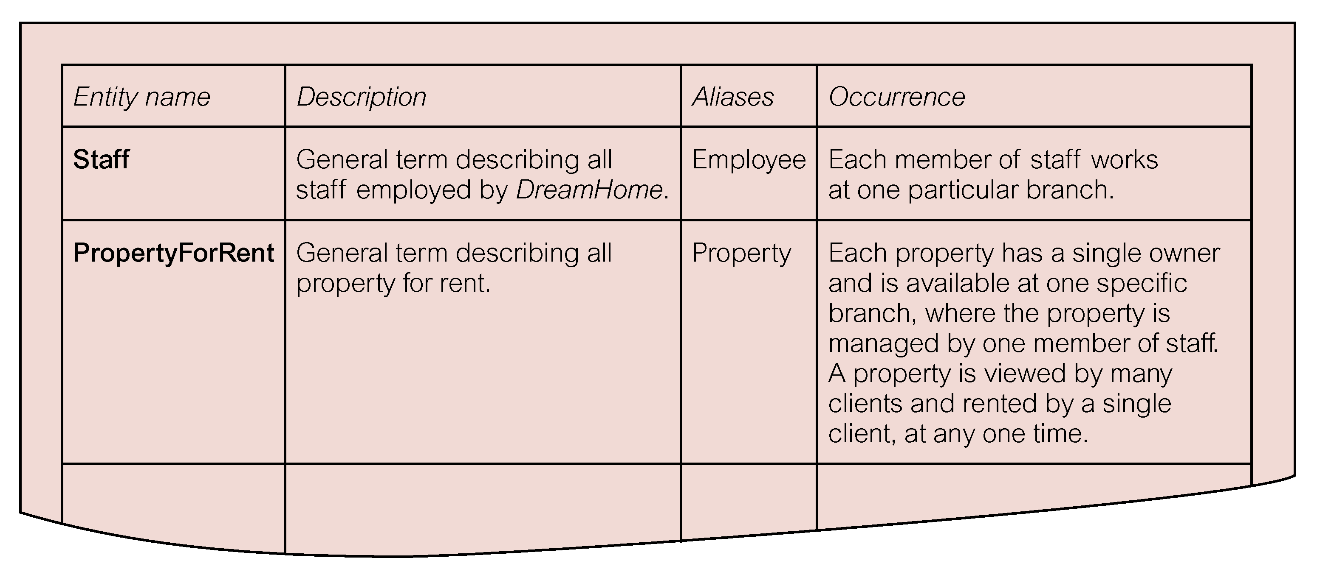
Extract from Data Dictionary for Staff View of DreamHome Showing Description of Entities

Slide 19
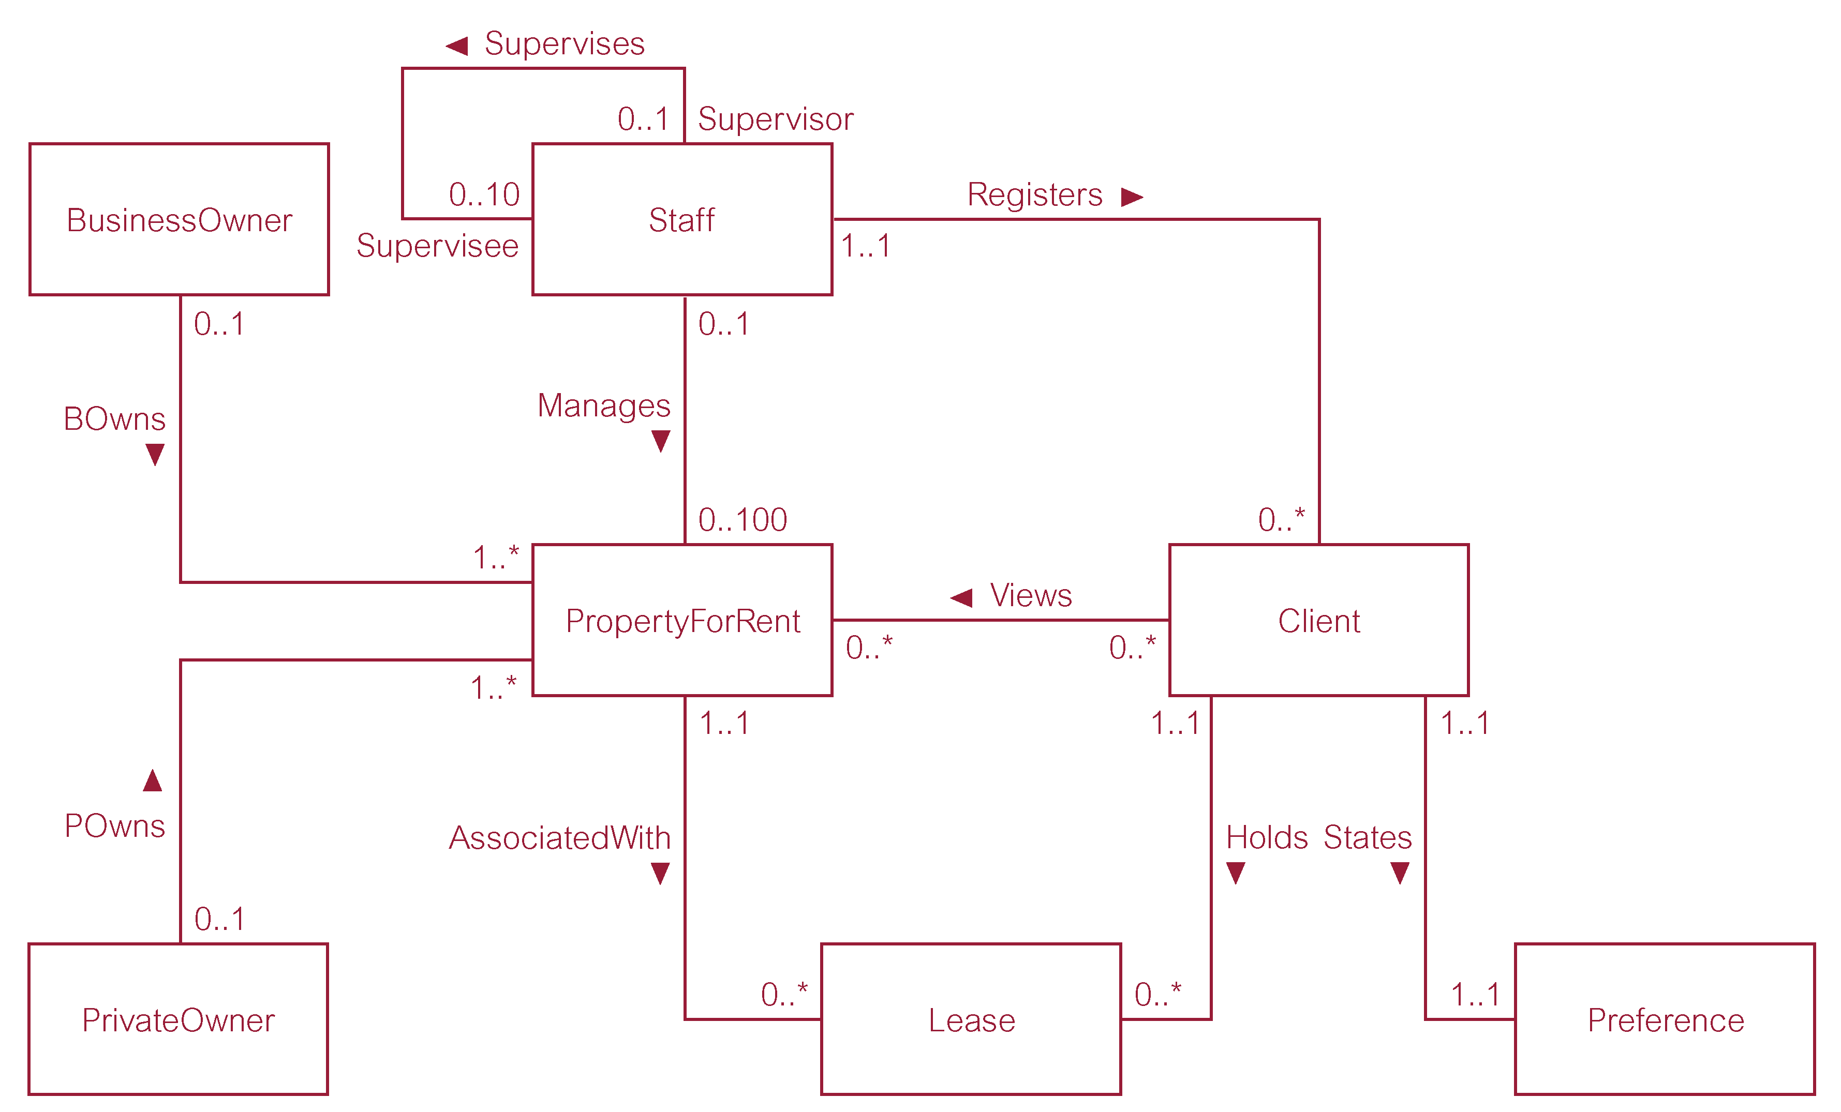
First-cut ER diagram for Staff View of DreamHome

Slide 20
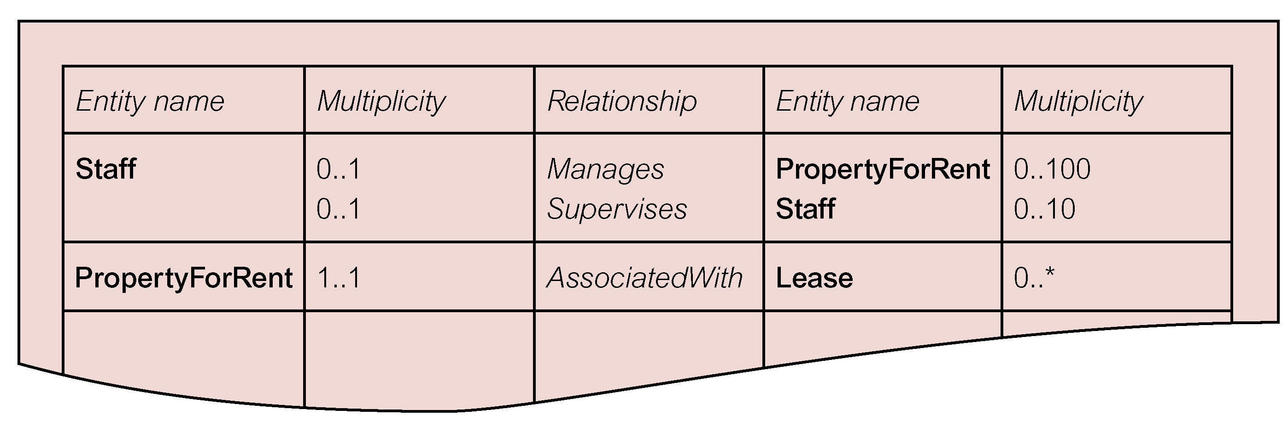
Extract from Data Dictionary for Staff View of DreamHome Showing Description of Relationships

Slide 21
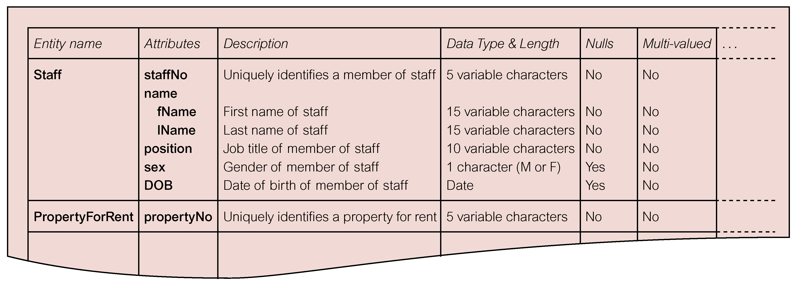
Extract from Data Dictionary for Staff View of DreamHome Showing Description of Attributes

Slide 22
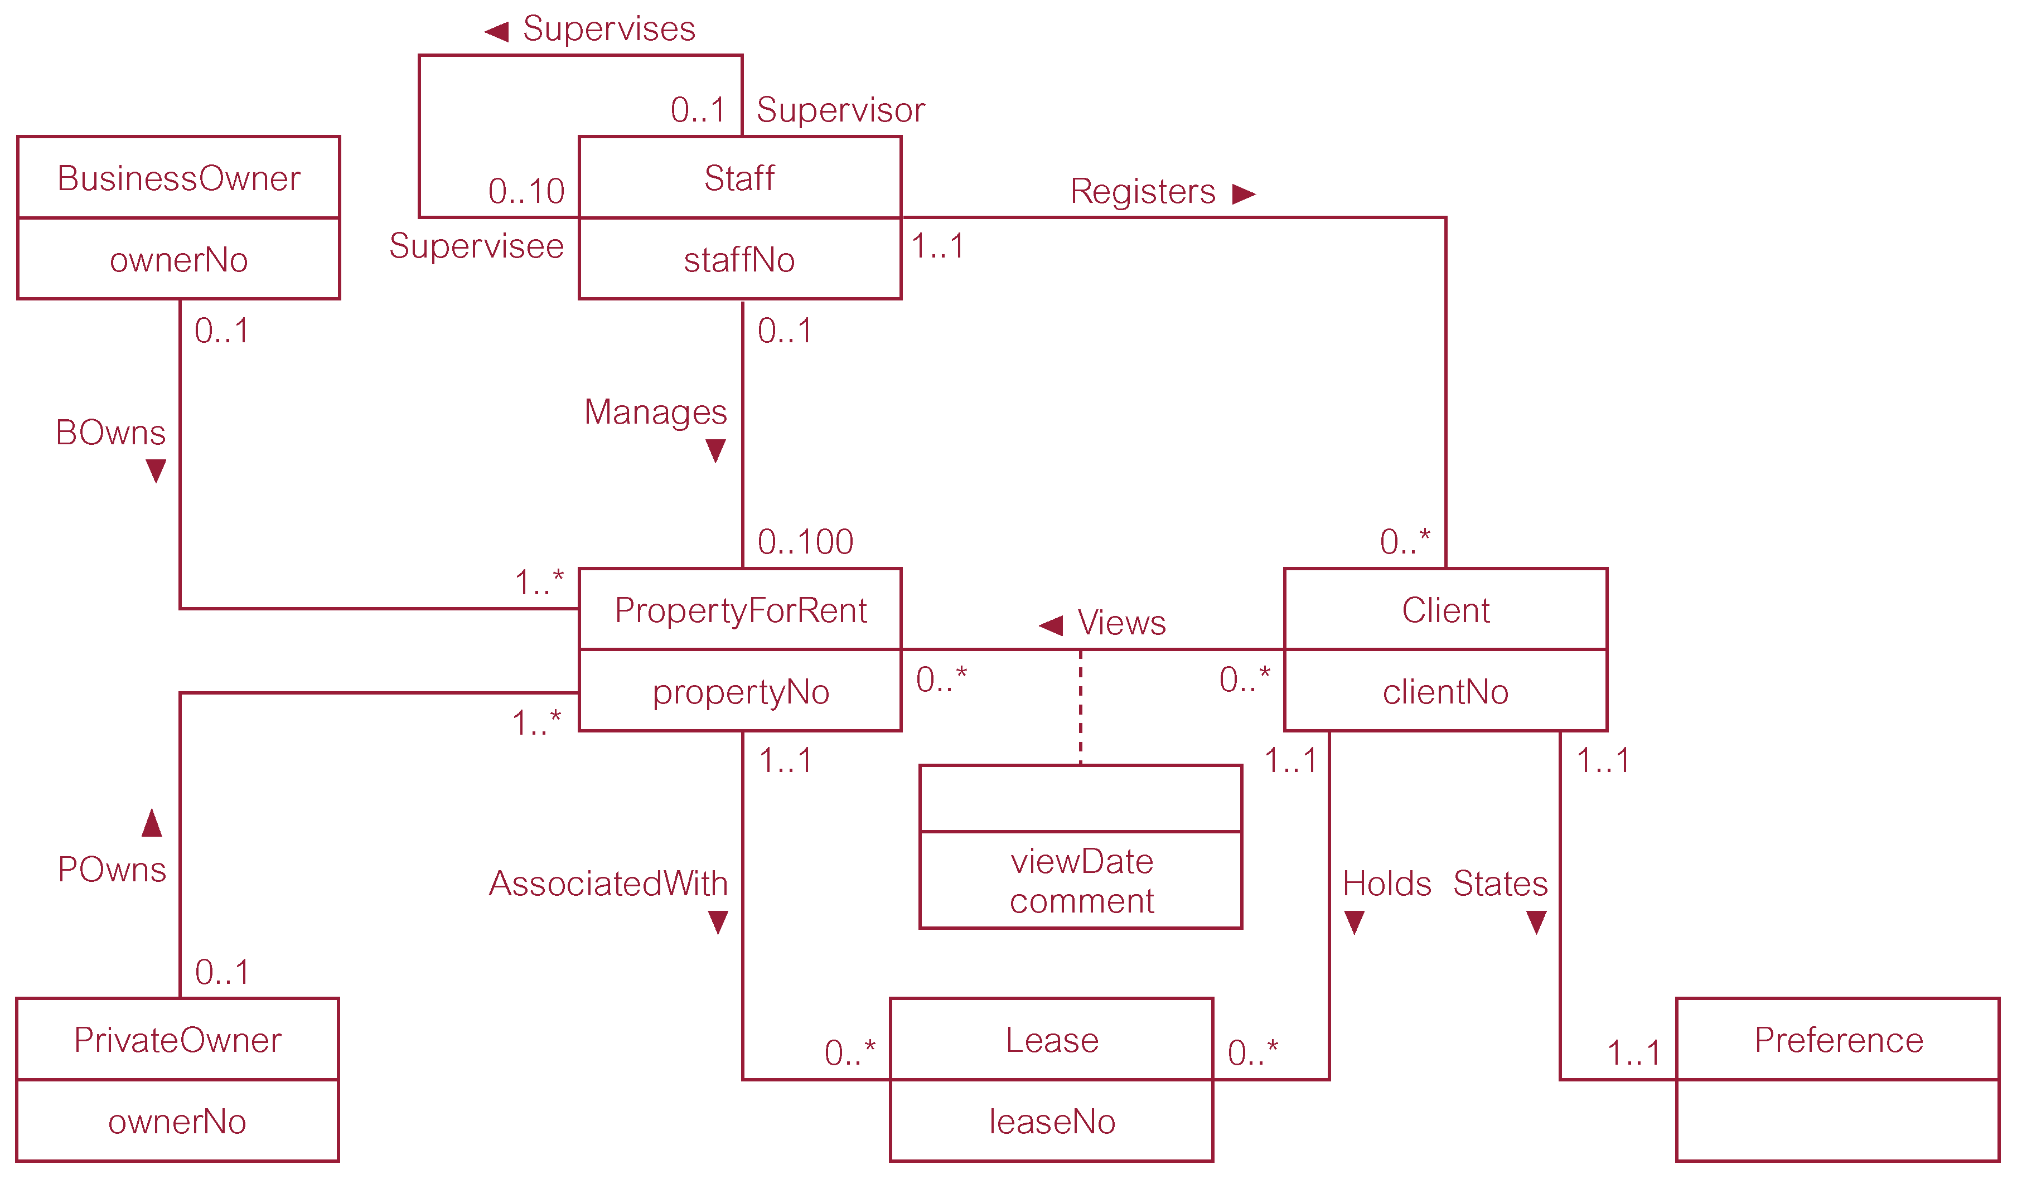
ER Diagram for Staff View of DreamHome with Primary Keys Added

Slide 23
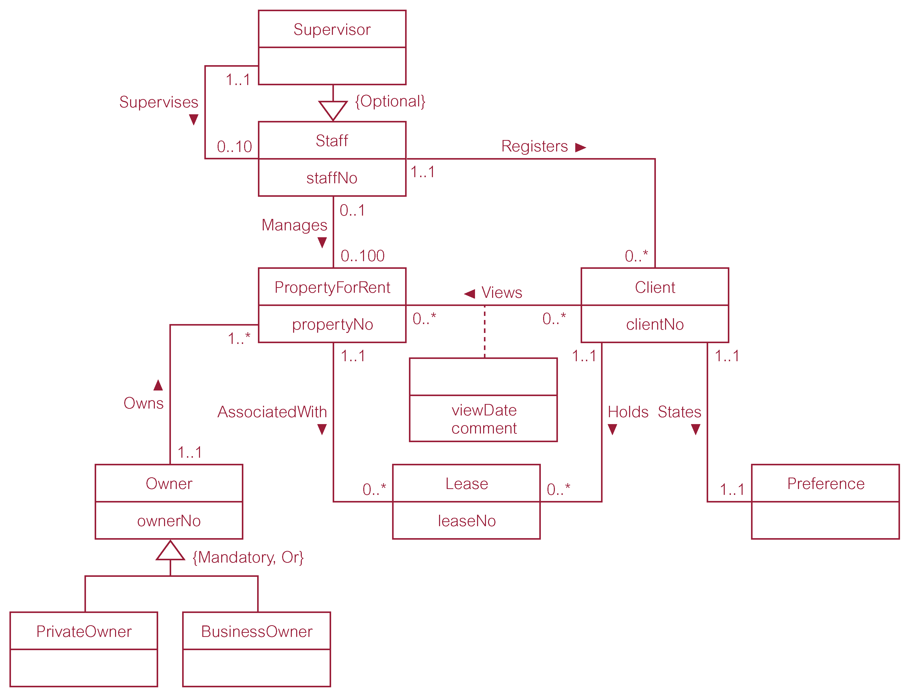
Revised ER Diagram for Staff View of DreamHome with Specialization / Generalization

Slide 24
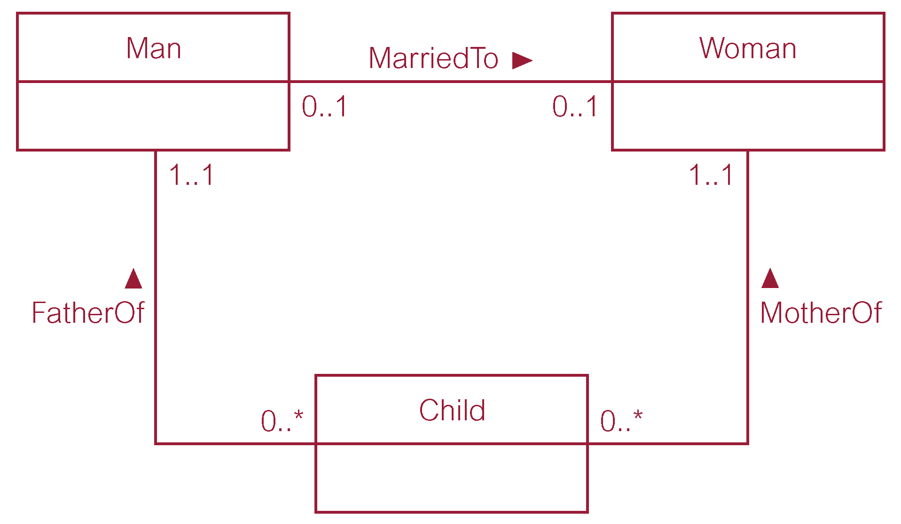
Example of a Non-Redundant Relationship FatherOf

Slide 25
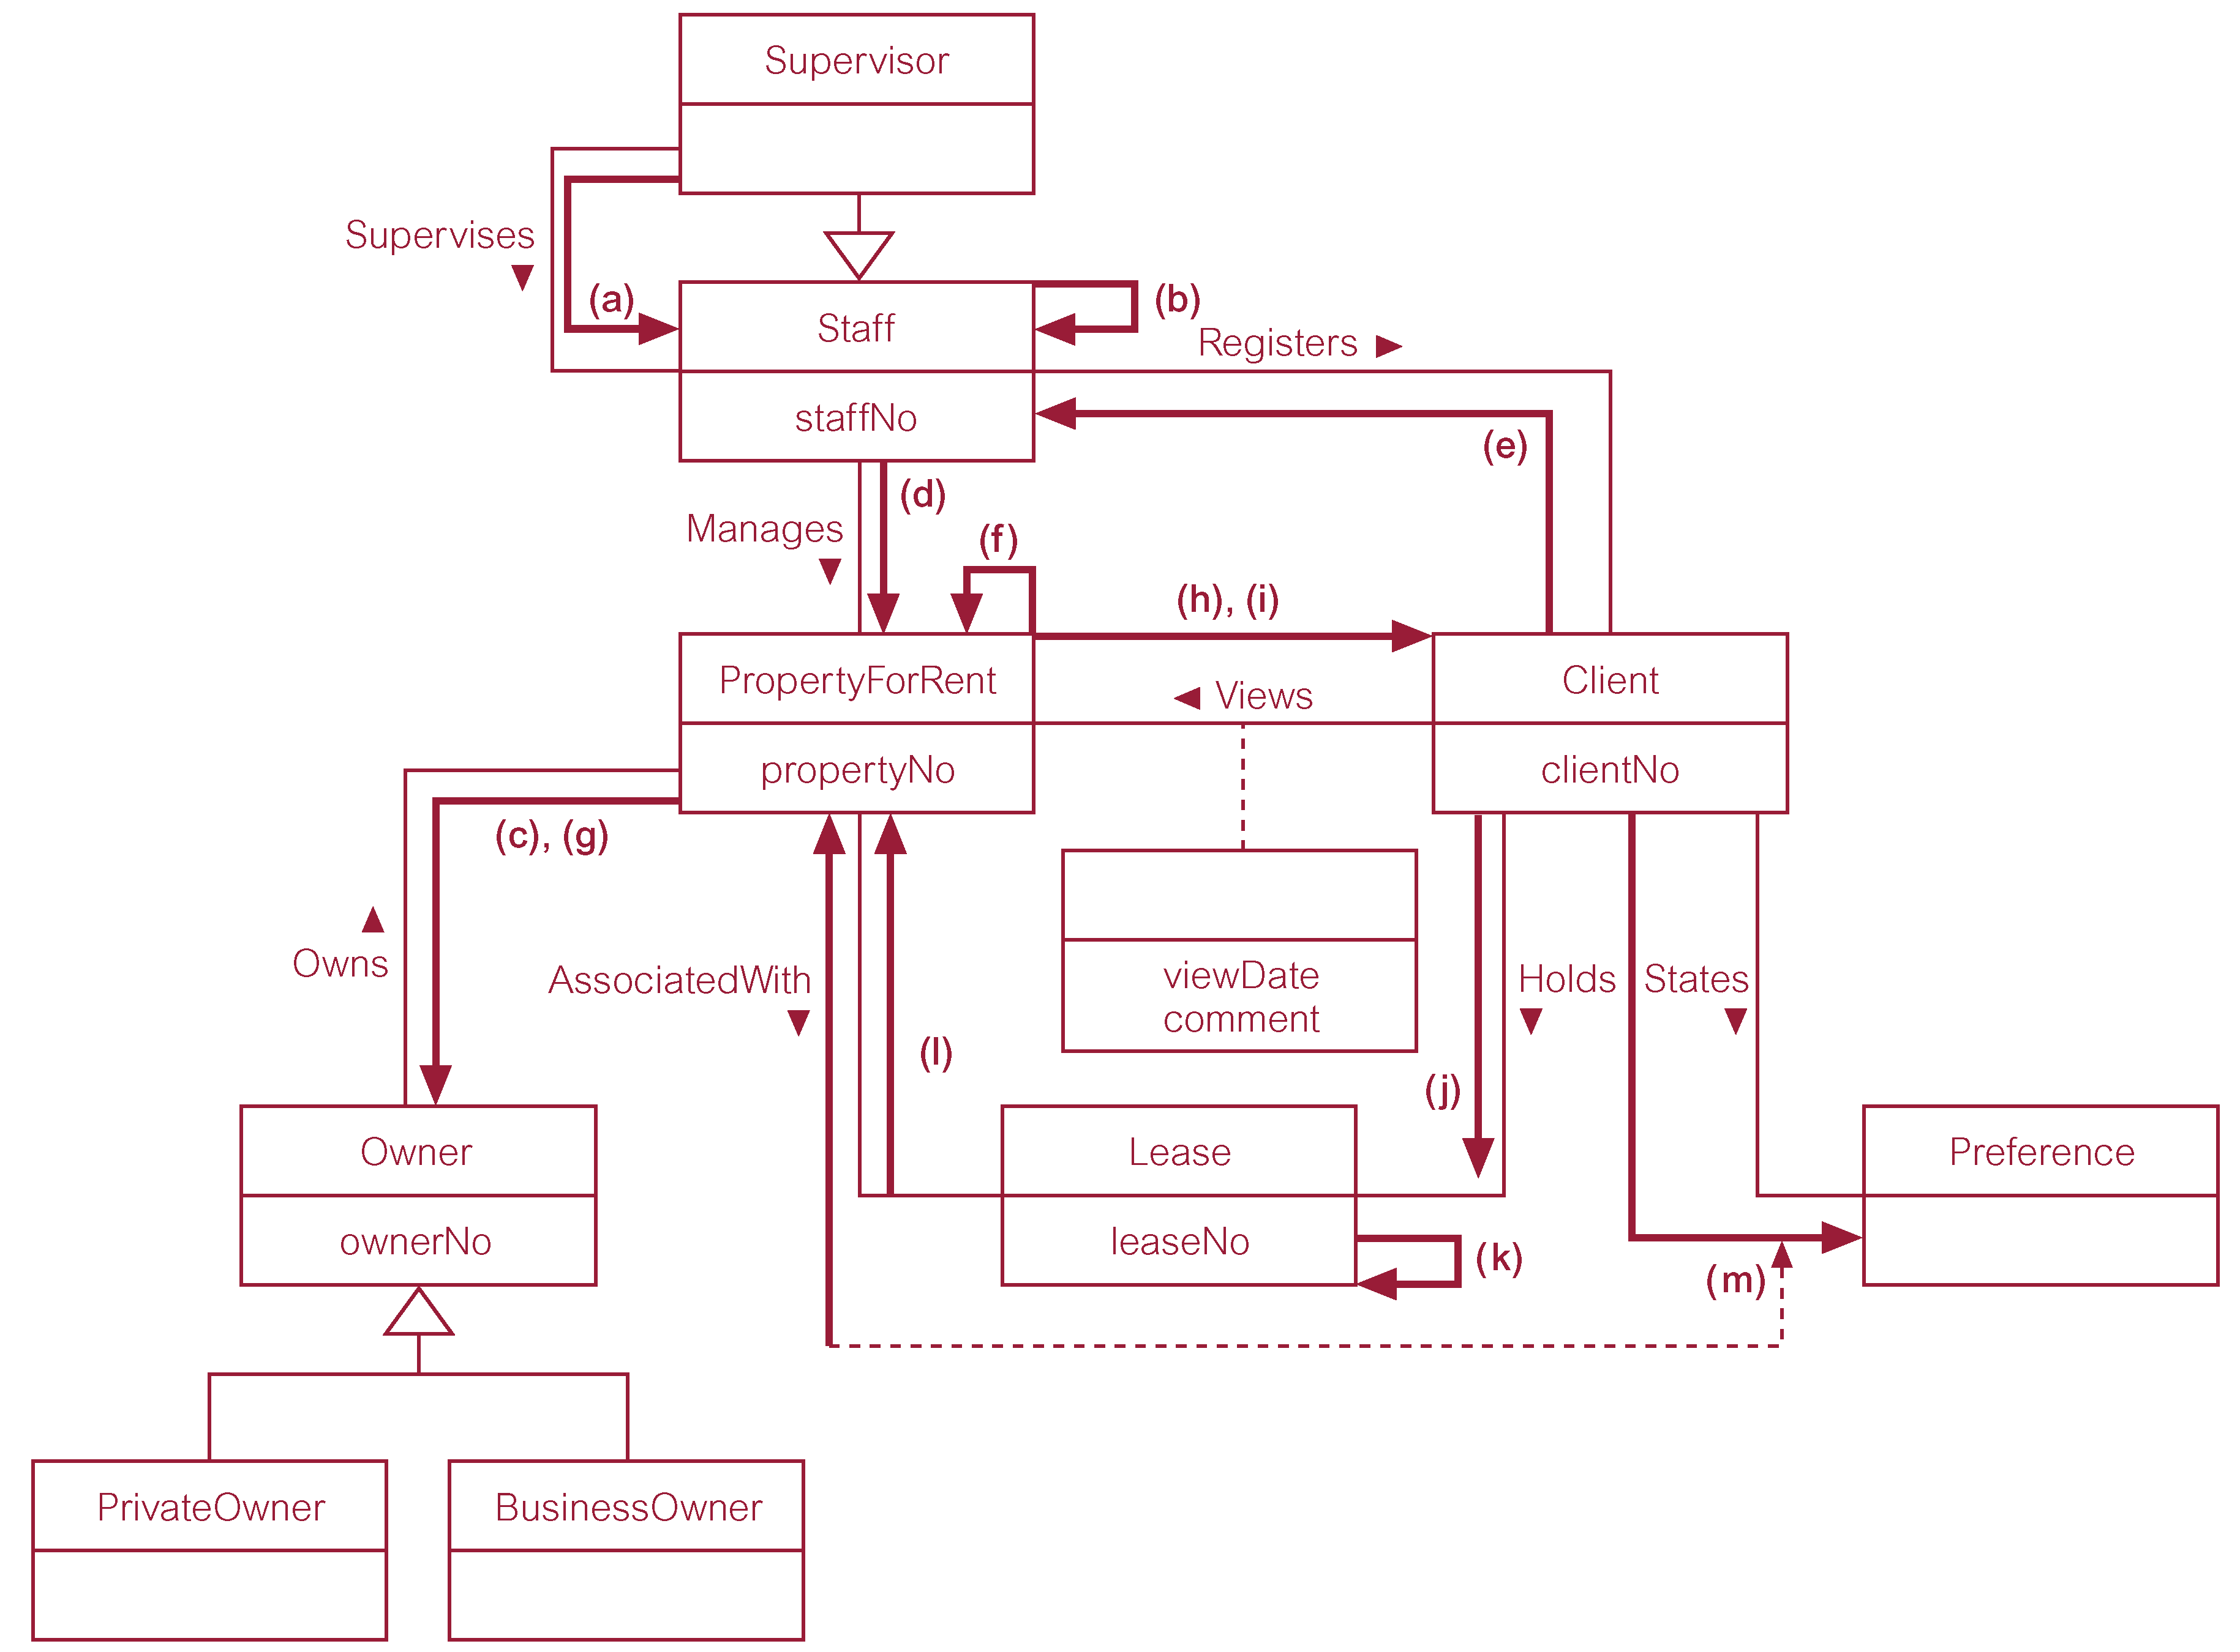
Using Pathways to Check that the Conceptual Model Supports the User Transactions

